Slide 1
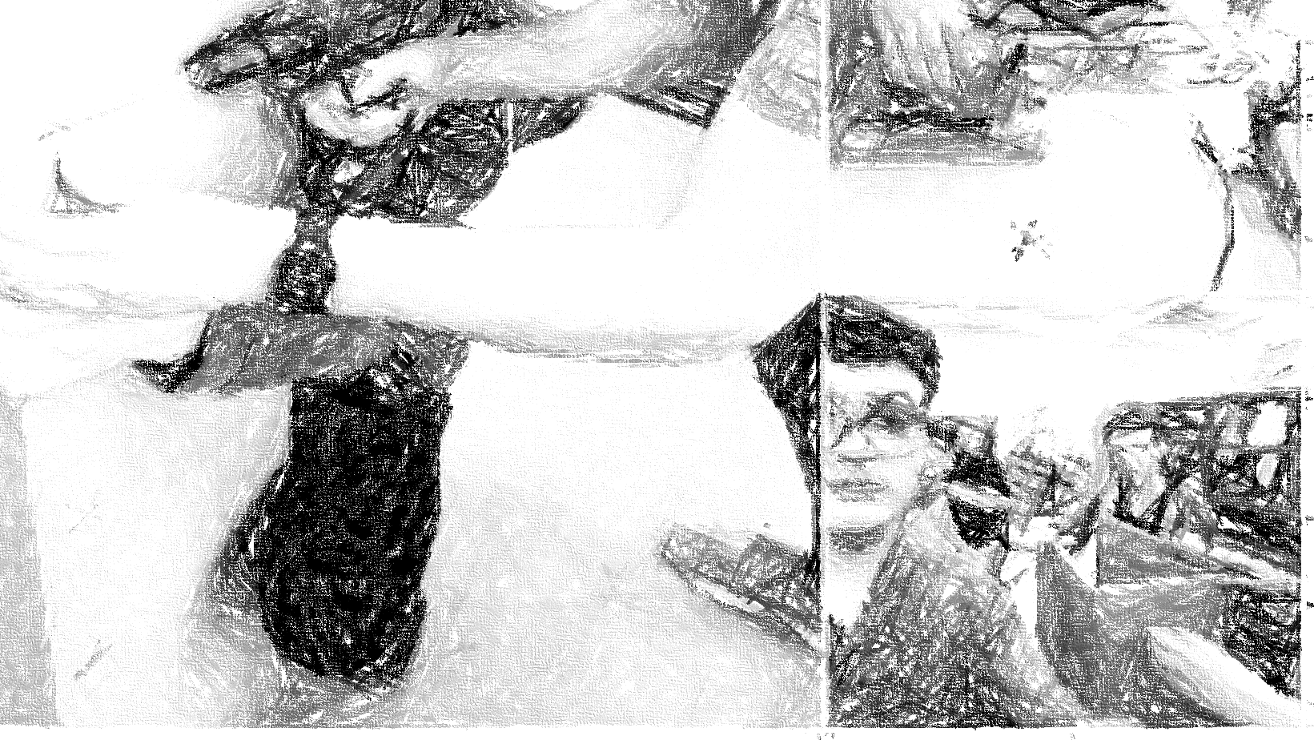
Smart Systems
Presentatie Poembak Delco

Slide 2
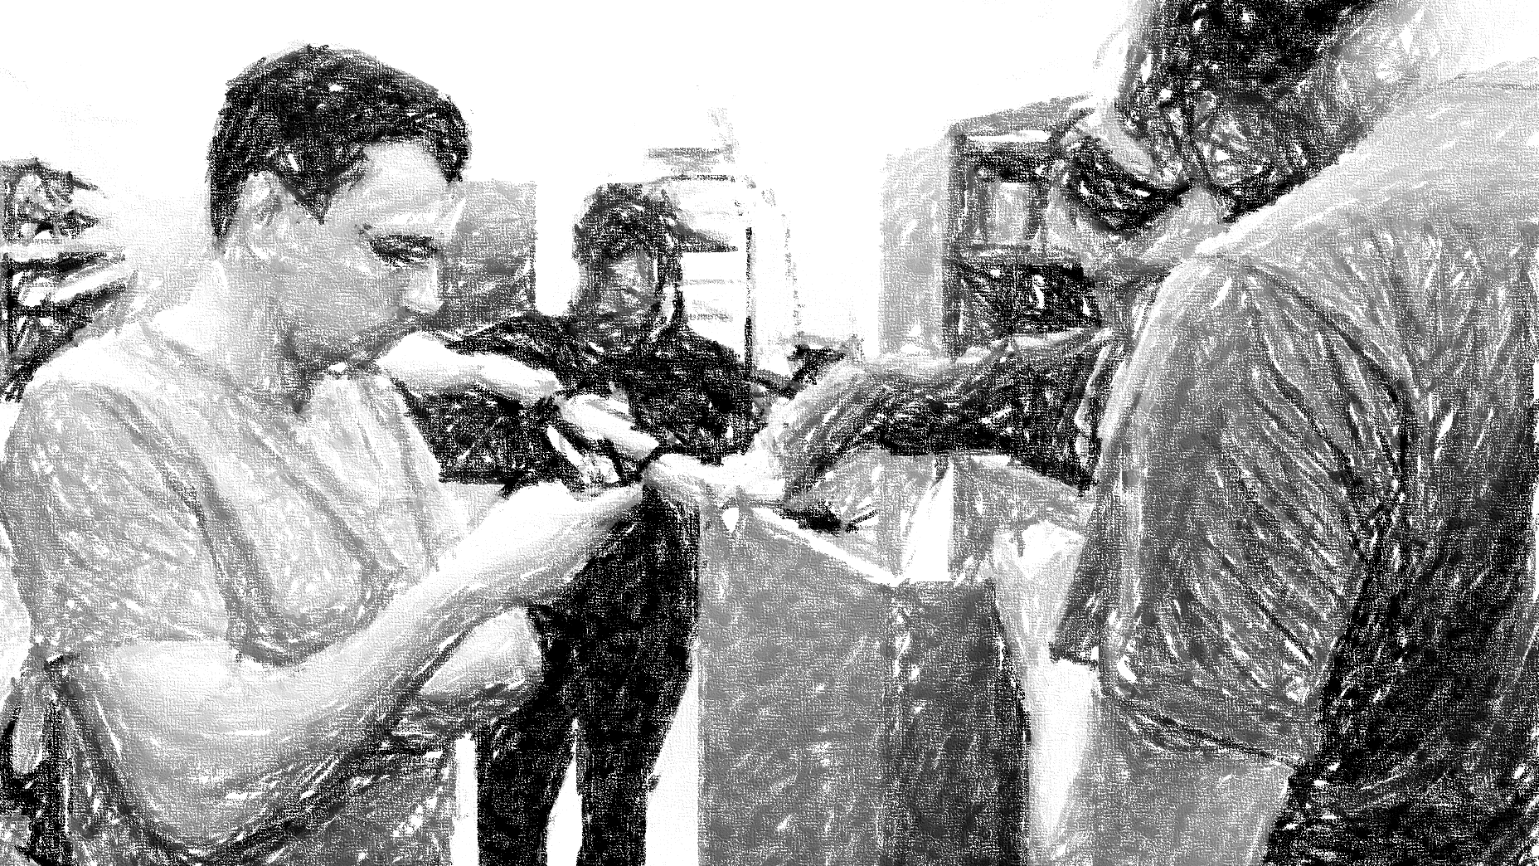
Meet the team
6 people, 1 robot

Slide 3
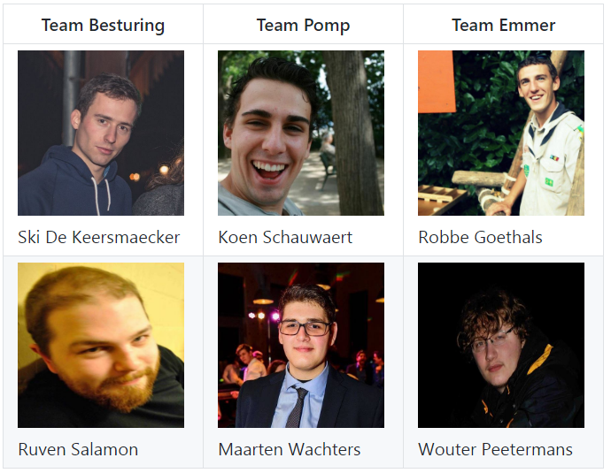

Slide 4
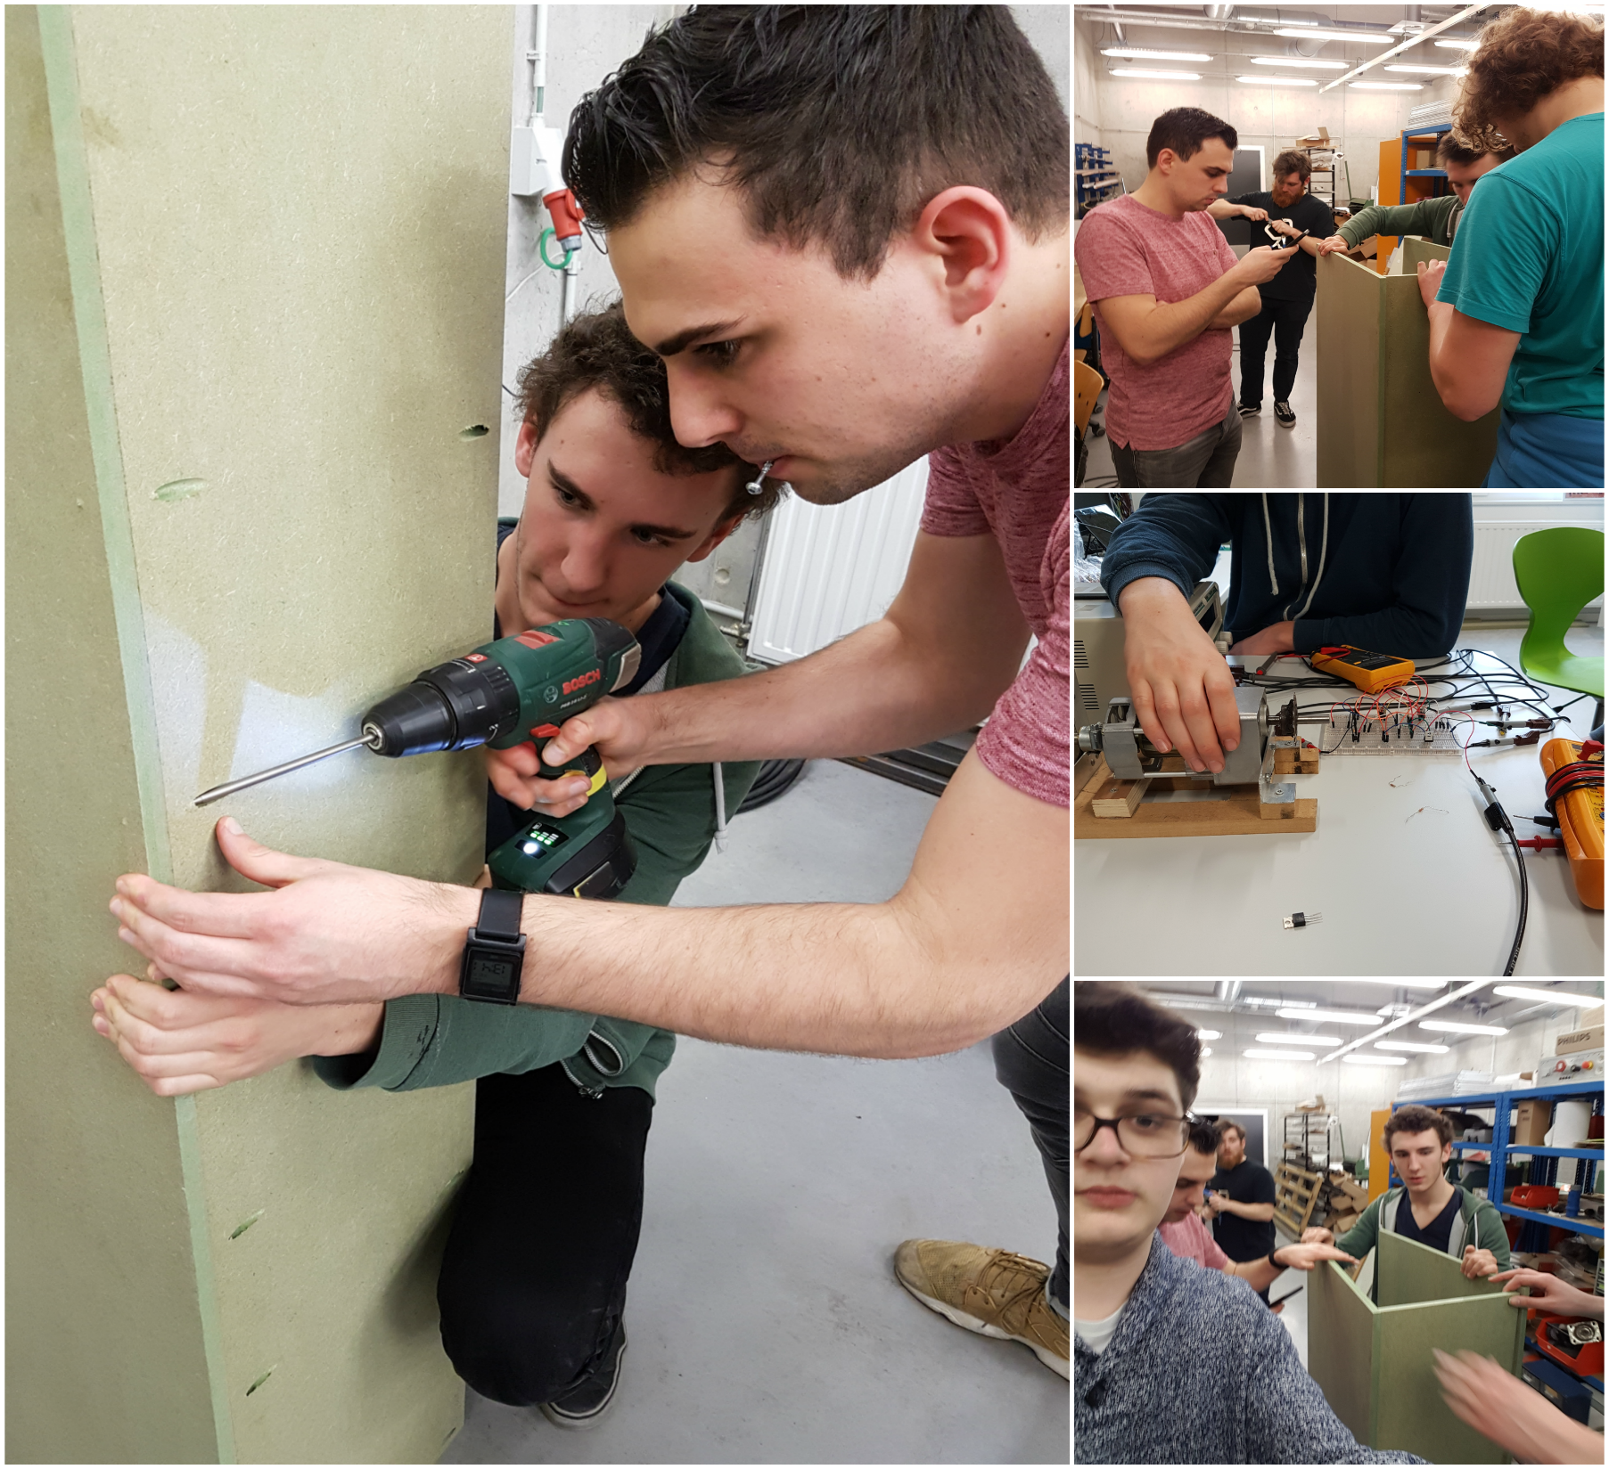

Slide 5


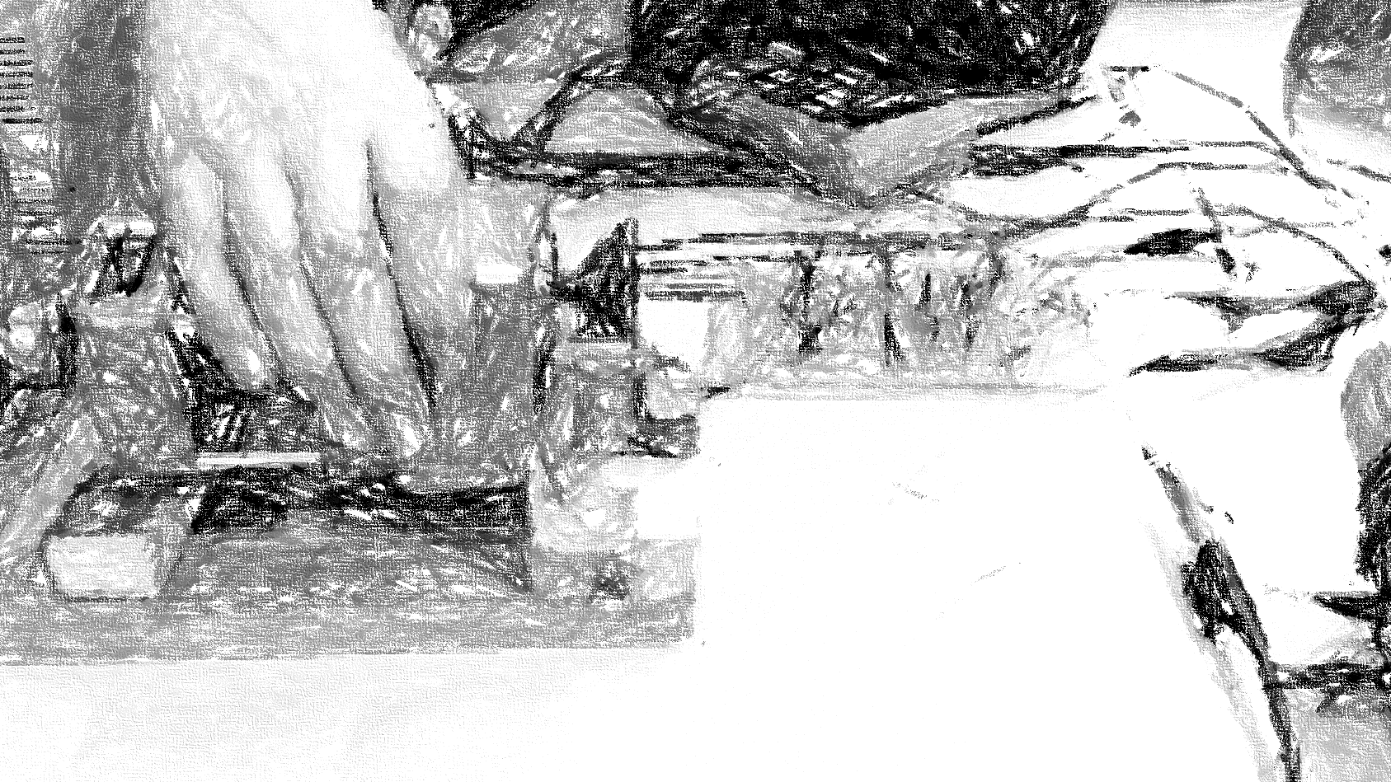



Progress

Slide 6
Checklist
Sponsoring CCM
Maken motorcontroller
Frame
Sturing motor
Sensoren inlezen
Doorsturen van data

Slide 7
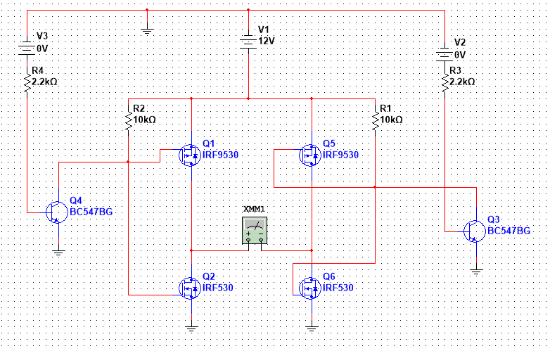
Schema motorcontroller

Slide 8
Beweging emmer

Slide 9
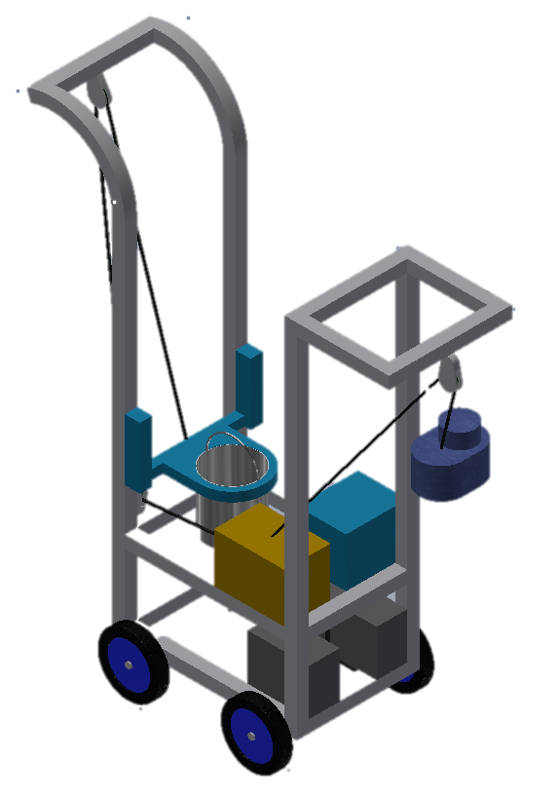
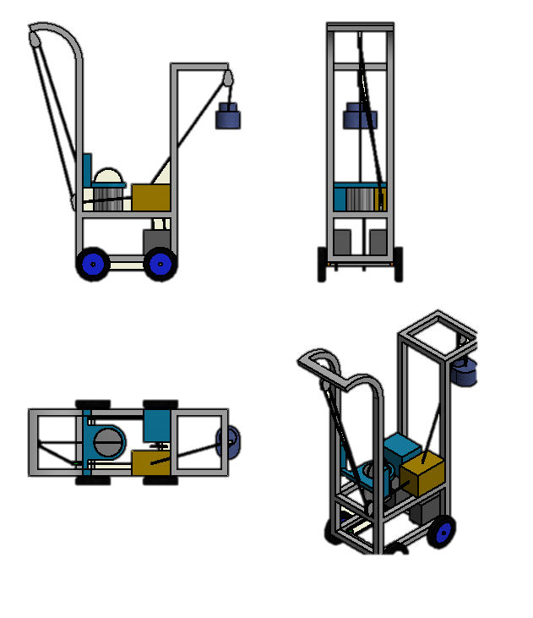
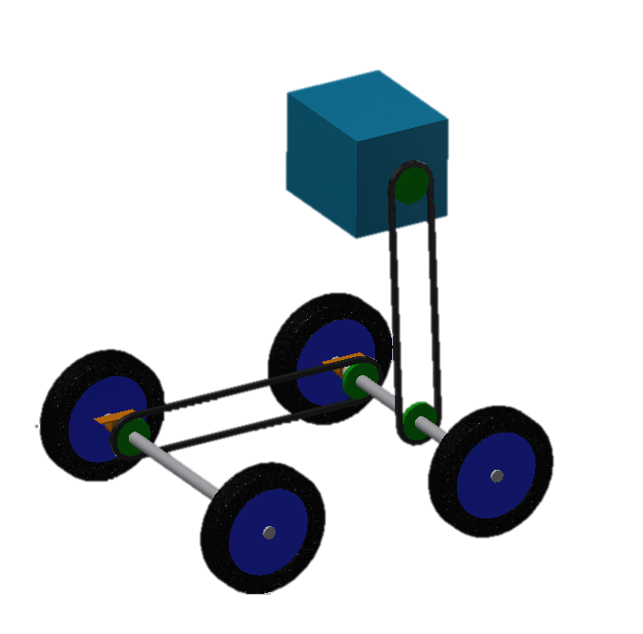

Slide 10
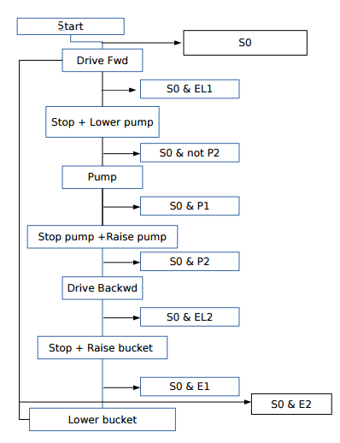
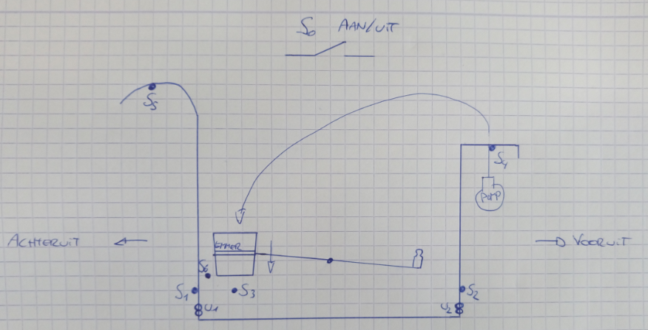
Graphset verloop

Slide 11
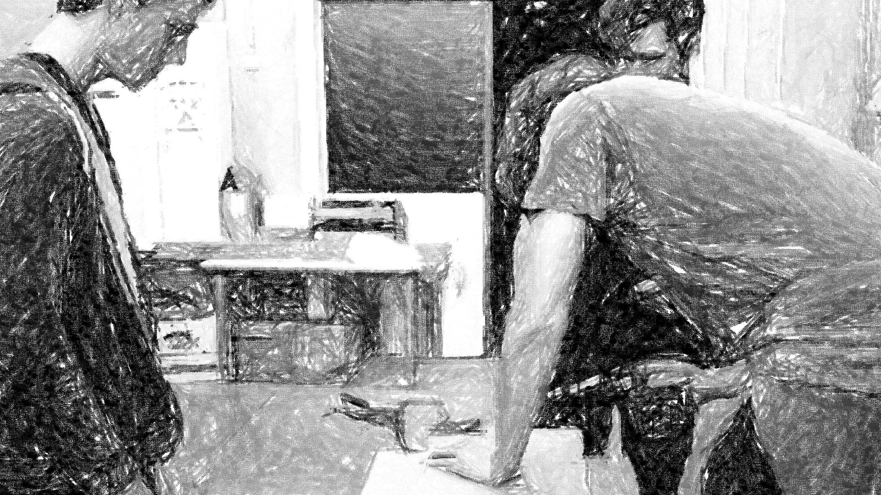
Documentatie

Slide 12
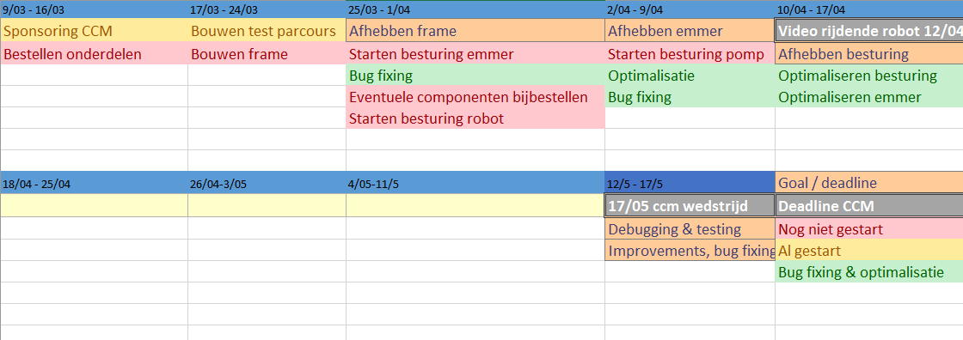
Planning

Slide 13
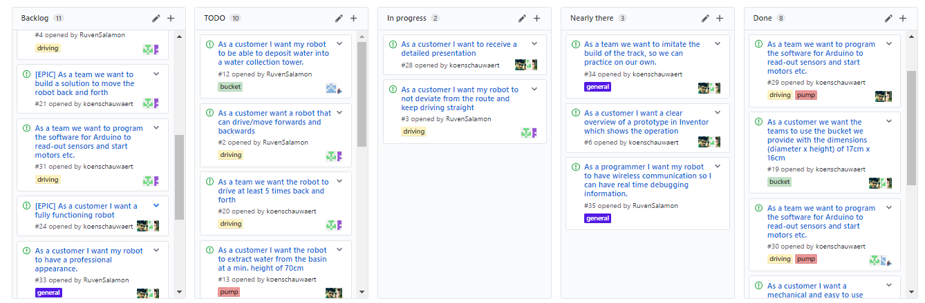
SCRUM

Slide 14
Links
Github: https://github.com/ccmteamap/robot
Wiki: https://github.com/ccmteamap/robot/wiki
Info CCM: http://www.ccm.nl/nl/trofee/
Issues & sprints: https://github.com/ccmteamap/robot/issues
Online scrum: https://github.com/ccmteamap/robot/projects/1

